Slide 1
An Analysis of NBA Spatio-Temporal Data
Megan Robertson
Master’s of Statistical Science Duke University
March 28, 2017

Slide 2
INTRODUCTION
Notes:
Why were you interested in this project?
Played basketball for all four years in college
Initially became interested in statistics because of its applications in sport
Project as a way to combine interests in statistics and basketball

Slide 3
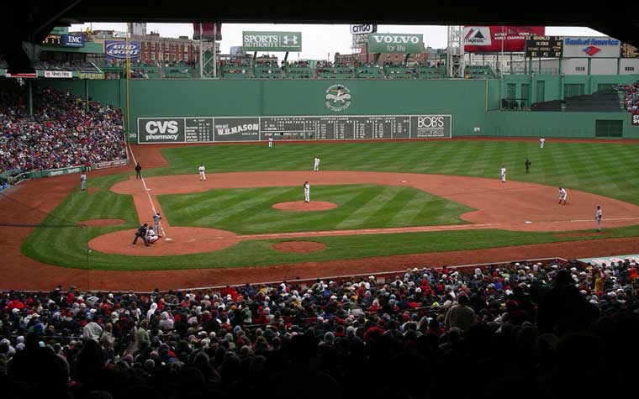
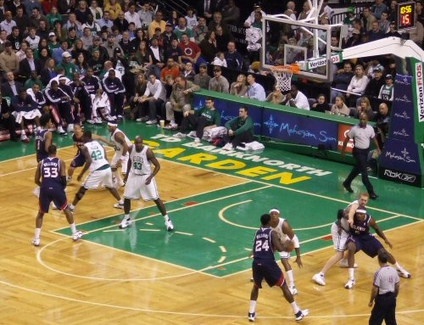
Challenge of Basketball Analytics
Notes:
Complicated aspects of analyzing basketball data
Have to capture the movement aspect of basketball
Baseball can be easily classified into discrete events (caught ball, run to first)
- players also tend to stay in the same areas (defense, offense on base paths)
http://internet128.com/images/boston-celtics-v-atlanta-hawks.jpg

Slide 4
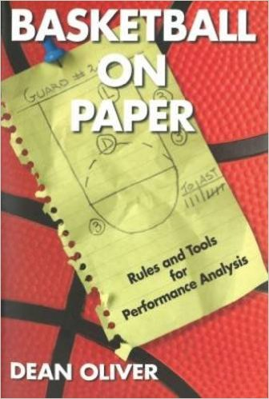
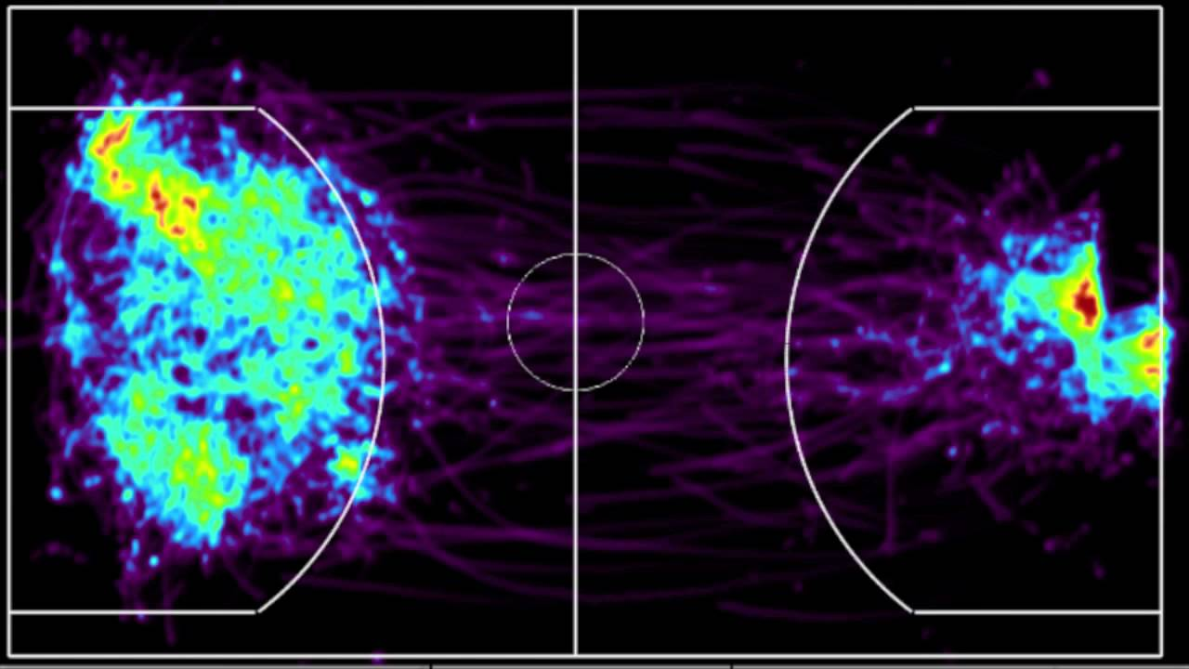
Development of Basketball Analytics
Notes:
What has been done in the field so far?
Sports analytics entered pop culture and became popular thanks to Moneyball
Baseball is the most developed sport in terms of time
Not really known what the teams are working on, confidentiality due to the competitive nature of the league
Companies like SportVU do publish papers on statistics/analysis used in their technologies, so some development but for the most part things are kept confidential
How much are the teams using the new technology that is available?
https://i.ytimg.com/vi/AkPEVVtWcPc/maxresdefault.jpg

Slide 5
Research Questions
Can the tracking data be used to provide insight on a deeper level?
What factors are important in influencing whether an NBA player will make a shot?
Notes:
Transition of trying to find utility of this new data

Slide 6
Project Roadmap
Moments Data
Filtered
Moments Data
Clean
Moments Data
Modeling Data
Classification Models
ESPN Data

Slide 7
DATA SOURCES
Notes:
Wanted to explore the advances in technology of the NBA

Slide 8
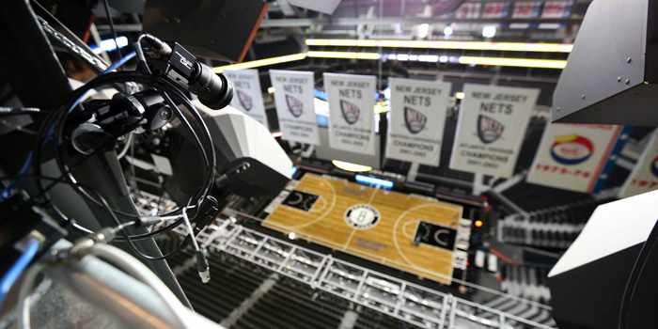
NBA Tracking Data
Notes:
Every arena contains cameras that take 25 images per second
This images are translated into coordinates for the players
Relatively new technology introduced in 2013-2014
NBA uses this technology on for the statistics section of its website
- traditional measures (rebounds, assists, minutes played, etc.)
- more detailed information such as distance run, speed, break down of shots in certain areas of the court

Slide 9
Moments Data
Notes:
NBA tracking data is proprietary and expensive
Moments data is a less detailed version used for the project
Used to be able to scrape data from the NBA website through a back door-ish method until January 2016
Fortunately got data from a github account
Describe the variables in the data set

Slide 10
ESPN Play by Play
Notes:
Moments data does not have information on events such as timeouts, shots, rebounds, etc.
ESPN website has play by play account for every NBA game
Scraped this information from the site and used it to filter the moments data to the time of interest

Slide 11
Data Issues
Notes:
Majority of the project spent on data management and data cleaning
Data littered with issues
Every image should have eleven rows – ten players and the ball
- some images were missing the ball, or had two balls, etc.
Images taken even when the game clock was stopped (timeout, free throw)
- much more than 2750 observations for a shot
Discrepancies between ESPN and moments data
- Players over 30 feet from the ball at the time of the shot (physically impossible)
Lots of cases had to be removed
- started with more than 400 games (around 100 shots a game) and final modeling data set was around 6000 shots

Slide 12
Data Issues
Moments containing more/less than eleven rows
Cameras keep shooting with a stop in play
Discrepancies between moments data and ESPN play by play

Slide 13
FEATURE GENERATION
Notes:
2750 rows: (10 seconds)x(25 images)x(10 players + 1 ball)
Modeling an event that occurs at one time in that data
Needed to determine how to use data to reduce it to one row for each shot
Created features to capture information that I thought would capture variability of whether a shot would go in
Use basketball knowledge to brainstorm features that might be useful

Slide 14
Modeling Variables
number of acceleration changes
defender (teammate) side of shooter
closest defender (teammate) angle
closest defender (teammate) distance
court zone
game clock, shot clock
number of close defenders (teammates)
number of possessions
other shot
quarter
shooter average velocity
shooter distance traveled
shooter velocity at shot
shot value
location of shooter

Slide 15
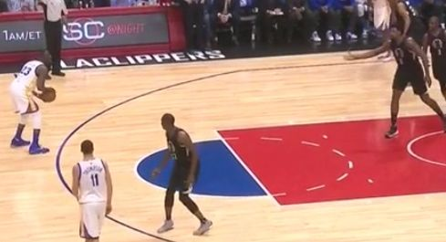
Distance to the nearest defender (teammate)
Euclidean distance between the shooter and nearest defender (teammate) at the time of the shot
Notes:
Captures information about the spacing
http://fansided.com/files/2016/02/Screen-Shot-2016-02-20-at-7.16.51-PM.jpg

Slide 16
Angle between shooter and closest defender (teammate)
Notes:
- Information about positioning of the defender relative to the shooter
- If defenders are in front vs. behind will tell different things about the difficulty of the shot

Slide 17
Side of defender (teammate)
Notes:
-Like angle, provides information about how the defender could be influencing the shooter
Spacing on the court

Slide 18
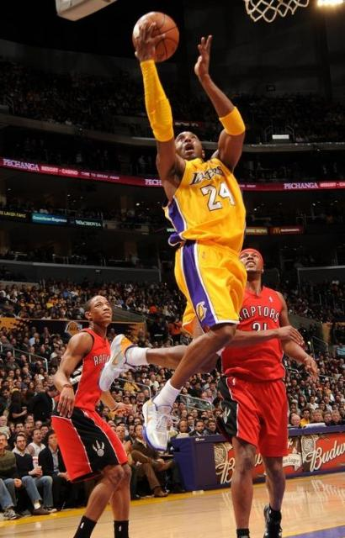
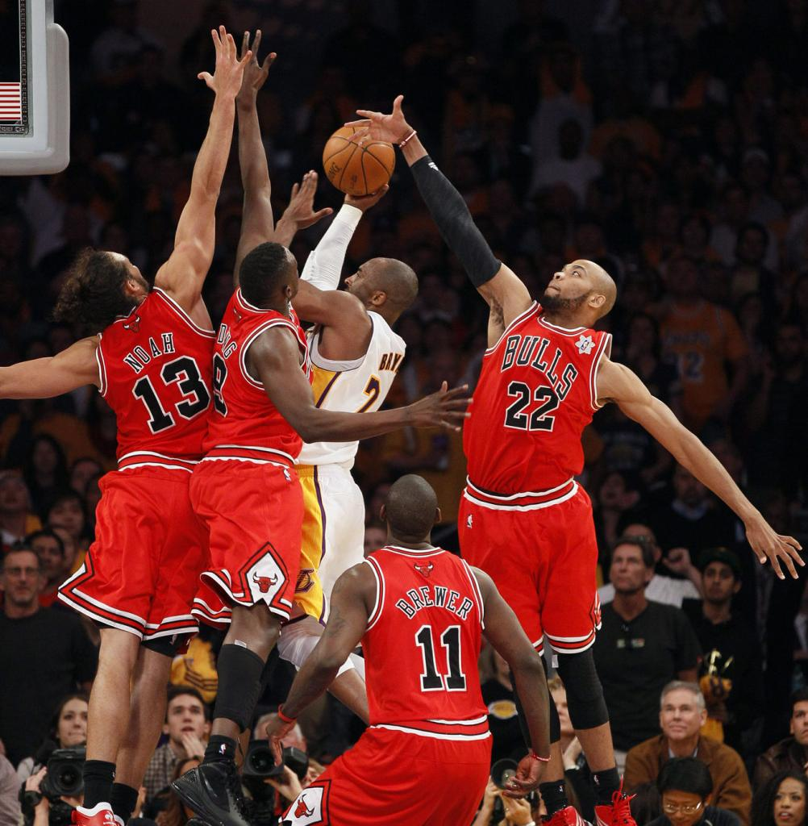
Number of close defenders (teammates)
Number of defenders/teammates within five feet at the time of the shot
Notes:
http://lakers.newssurge.com/gallery/d/276458-3/Kobe+Bryant+knifes+through+2+Raptors+defenders+for+the+layup.JPG
http://i.imgur.com/yC16Jwa.jpg

Slide 19
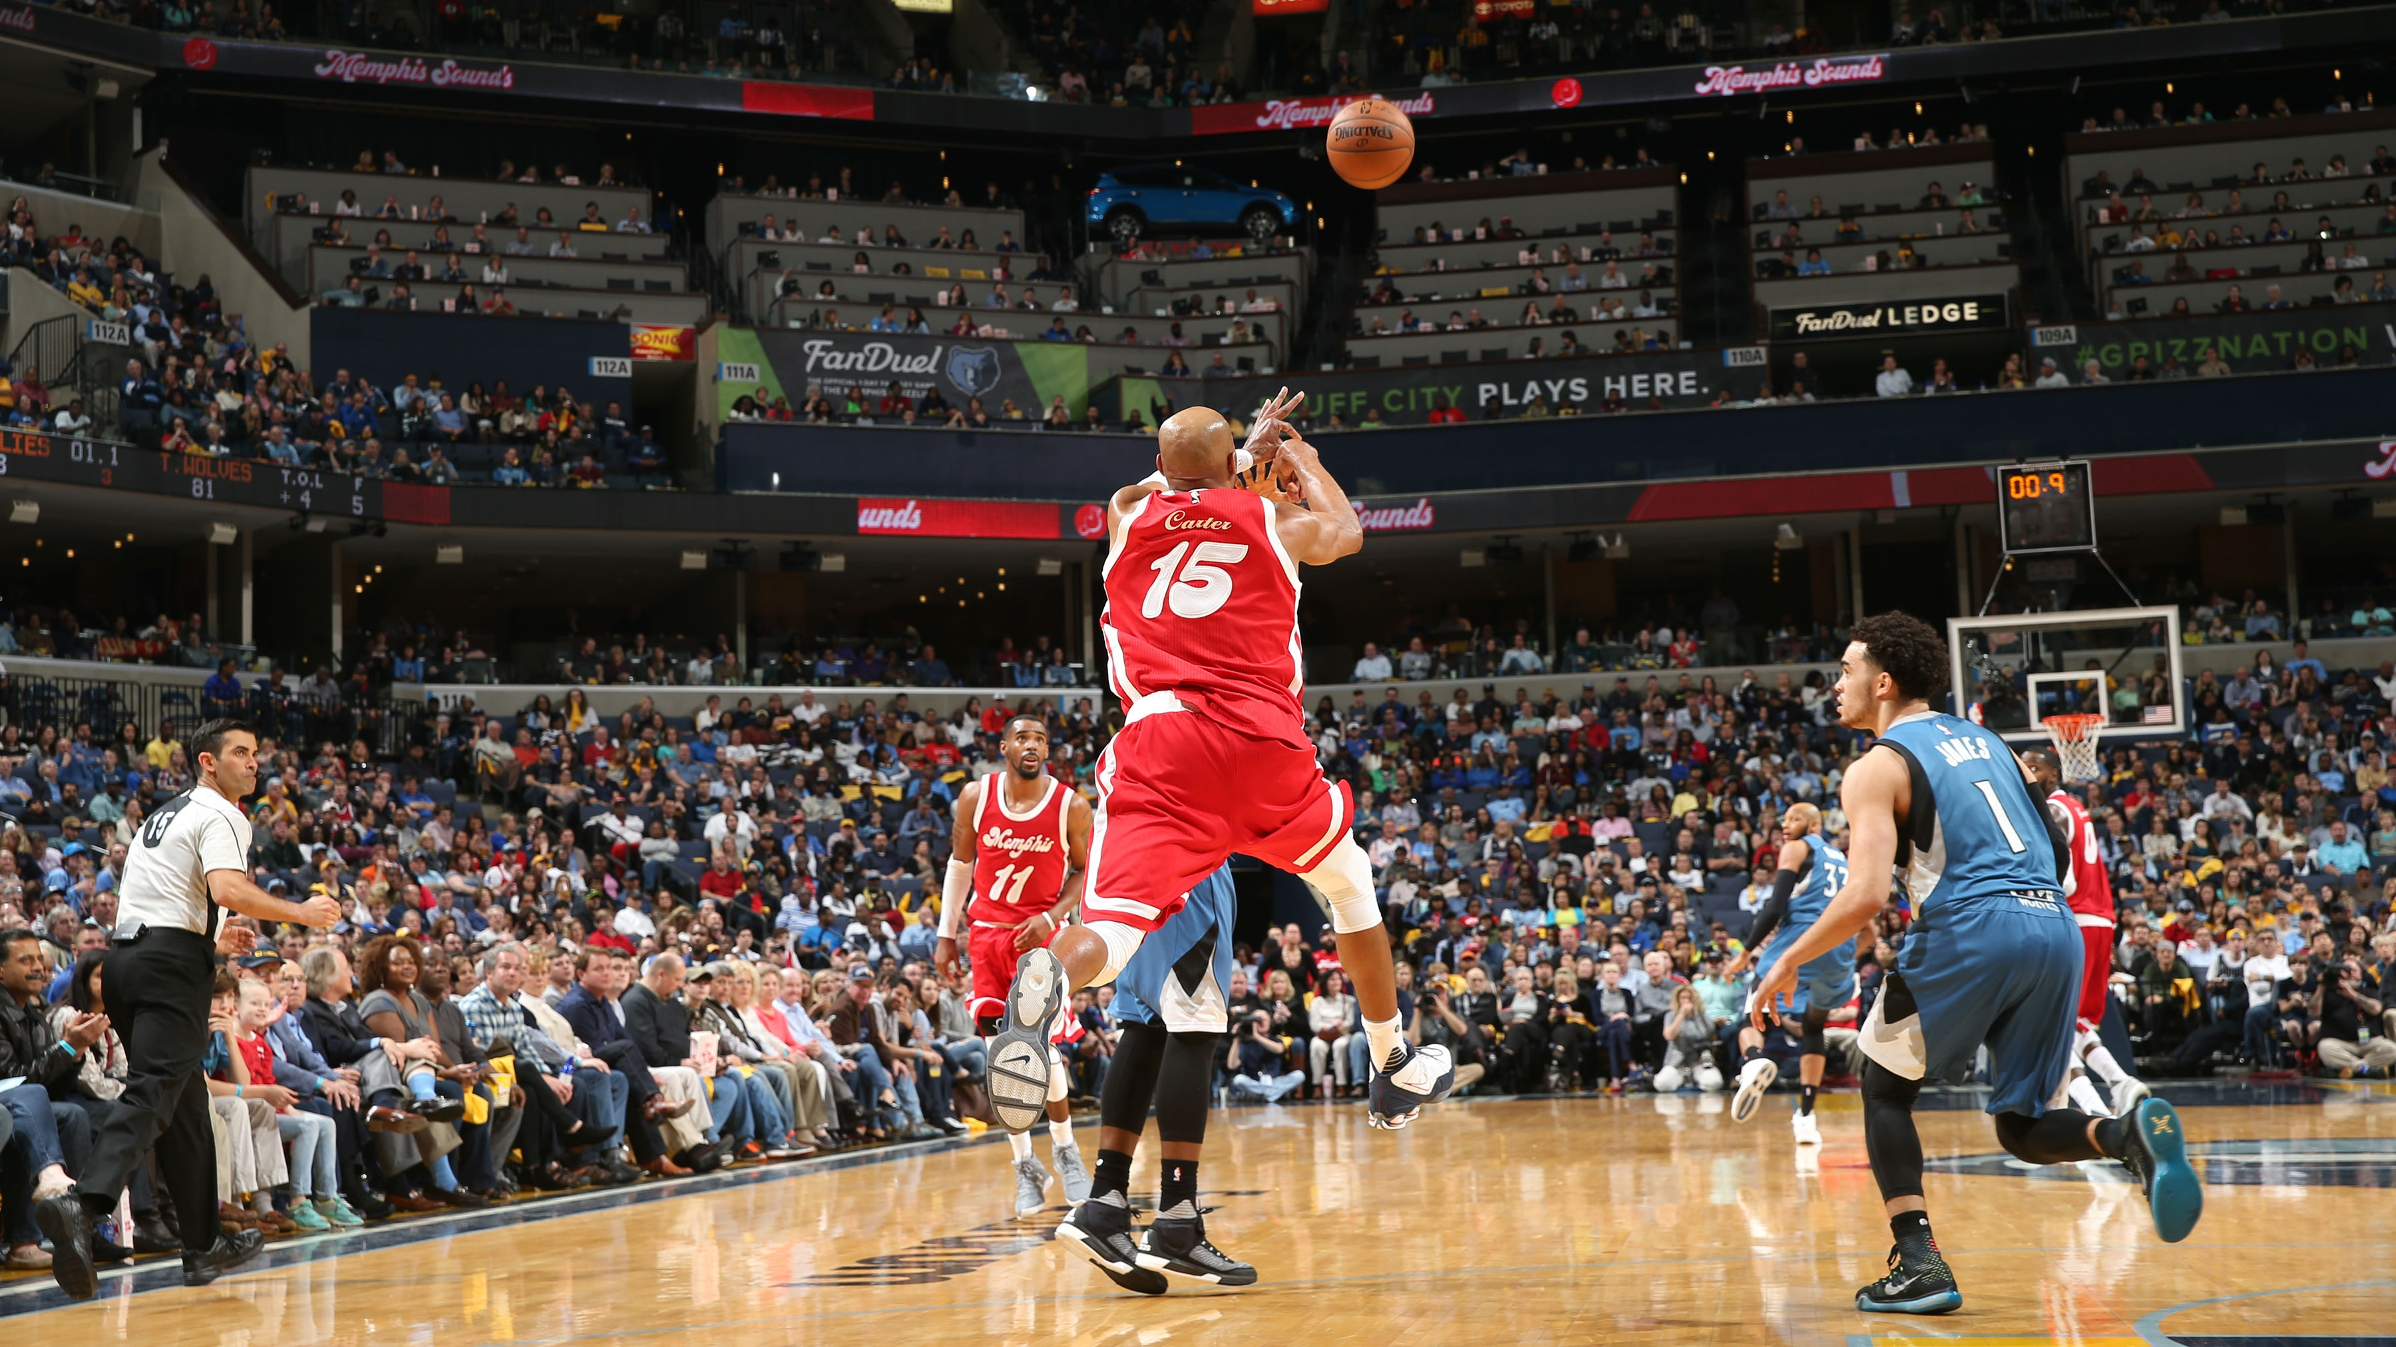
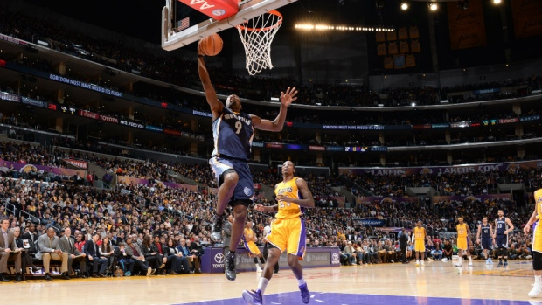
Distance from the basket
Notes:
The farther a shooter is from the basket, the more difficult the shot
However, it is not this simple
Taller defenders are closer to the basket, need to account for this information with other variables
http://images.performgroup.com/di/library/sportal_com_au/eb/f3/vince-carter_9f6fgyvuupa71acjufd68v5eq.jpg?w=3600&h=2025&quality=100
https://i.cbc.ca/1.2889197.1420346515!/fileImage/httpImage/image.jpg_gen/derivatives/16x9_620/tony-allen.jpg

Slide 20
Court zone

Slide 21
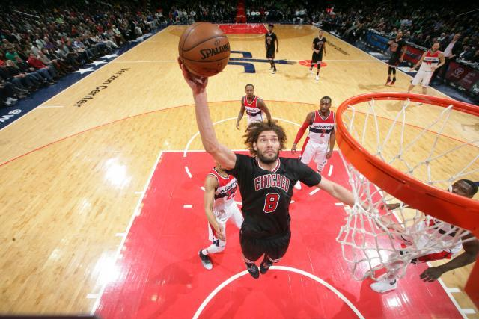
Distance traveled
Notes:
More distance could mean a fast break and they are more tired
Fatigue makes a jump shot difficult, but a fast break lay-up/dunk is pretty easy

Slide 22
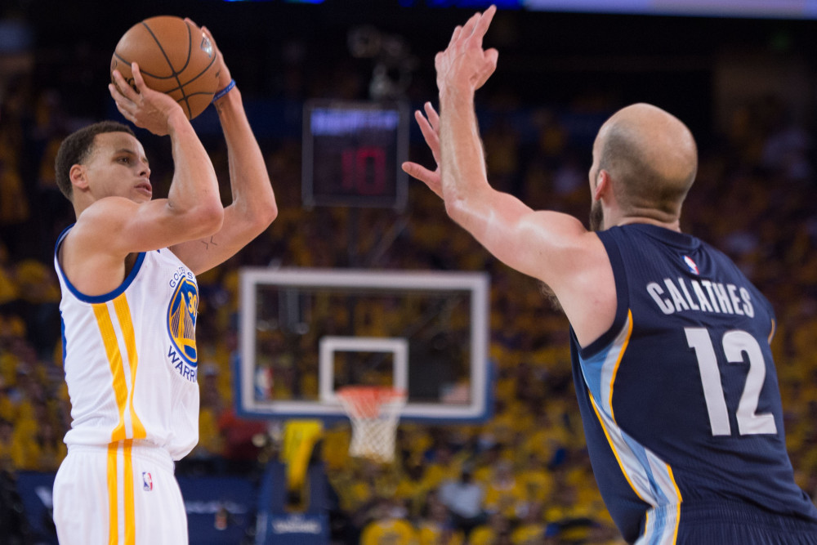
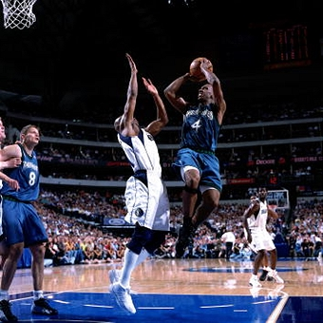
Shooter velocity
Notes:
Velocity at the time of the shot – more difficult if a player is moving instead of a set shot
Average velocity – also gives a sense of fatigue
https://usatftw.files.wordpress.com/2015/05/usatsi_8550645.jpg?w=1000&h=667
http://cache1.asset-cache.net/xr/611239.jpg?v=1&c=IWSAsset&k=3&d=133BFC9465023B04D1A643D247440905DFE8BF2A08AD5F63C91FE0DA142F3B7B

Slide 23
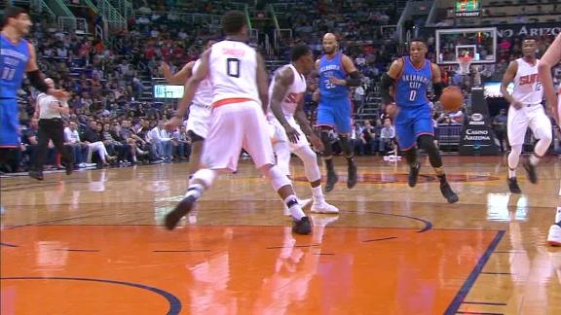
Changes in acceleration
Number of times magnitude of acceleration is at least ten
Notes:
- Looking at the size of the accelerations of the player in the ten seconds before hand
- Trying to capture hesitation moves or cuts

Slide 24
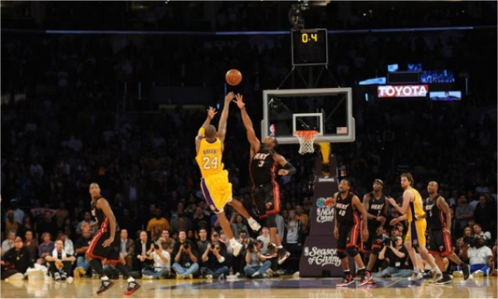
Game clock, shot clock
Notes:
Shooter might be forced into a bad shot if the shot clock or the game clock is running out
http://img.cinemablend.com/cb/b/a/7/4/4/b/ba744b79df65c33823ca605e4e7f56f947475f229bea8622c66cfb654c9d95aa.jpg

Slide 25
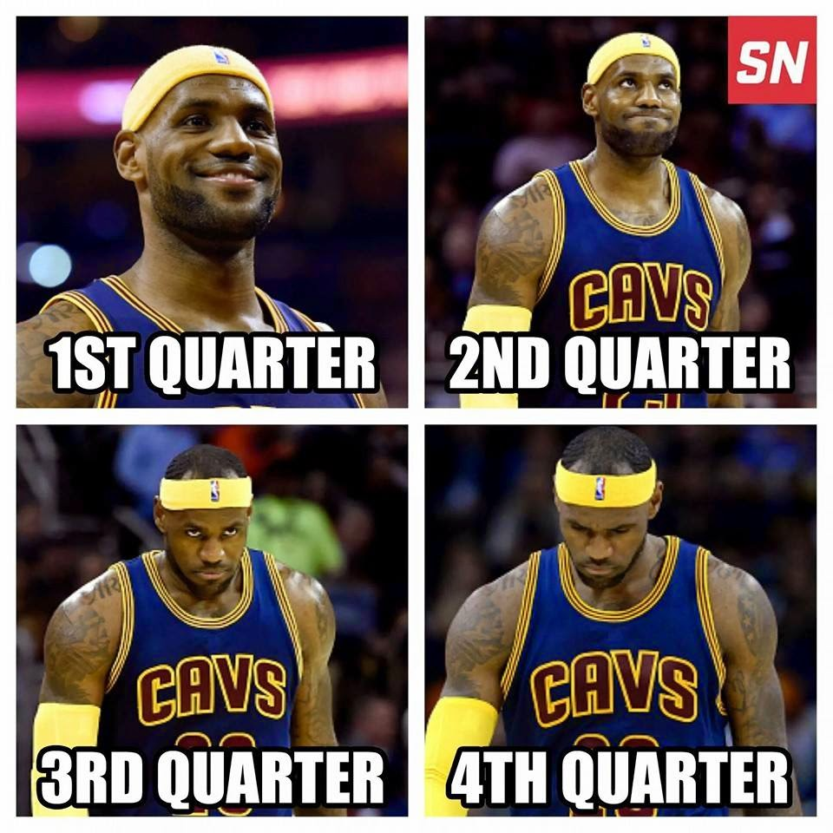
Quarter
Notes:
http://4.bp.blogspot.com/-JyKrq-5fPsk/VFOhM0rizyI/AAAAAAAAYyU/1AdDHTM_a44/s1600/1st%2B4th%2Bqt%2BLebron%2Bjames%2Bback%2Bto%2Bmiami%2Bknicks%2Bvs%2Bcavs%2Bloss%2Bfunny%2Bnba%2Bmeme.jpg

Slide 26
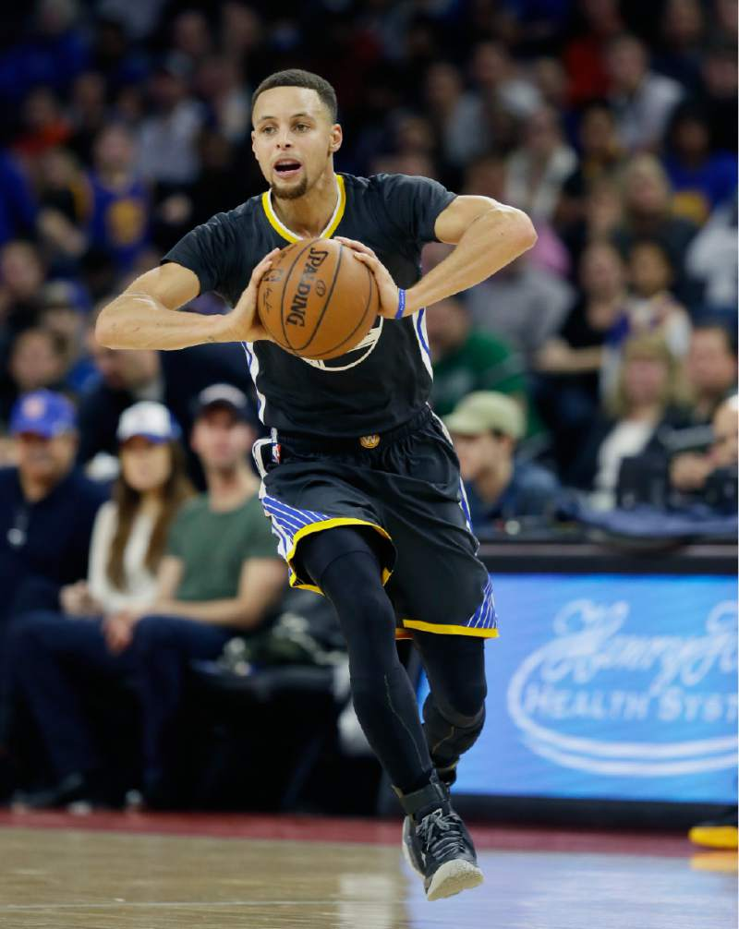
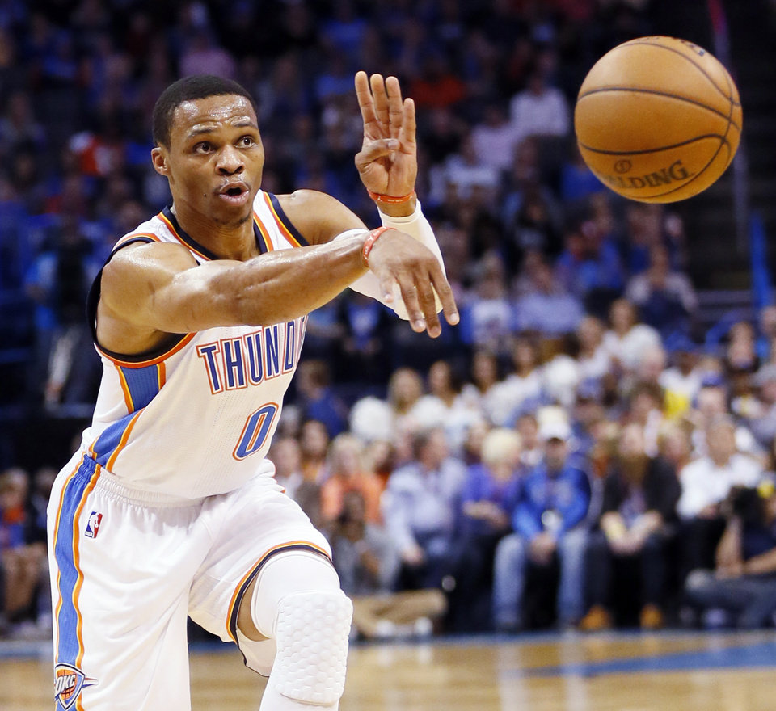
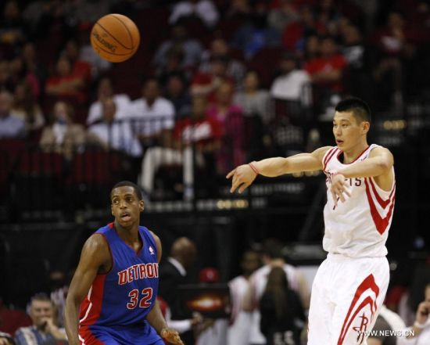
Number of possessions
Notes:
Is this a set play, rapid passing?
http://img.news.sina.com/sports/p/2012/1111/U150P5029T2D525342F24DT20121112091356.jpg
https://cdn2.newsok.biz/cache/r960-n_10bce606c5e7bdac8f598702801a0a54.jpg
http://www.pressdemocrat.com/csp/mediapool/sites/dt.common.streams.StreamServer.cls?STREAMOID=jXweL3WUCy0FpeQrsP92pc$daE2N3K4ZzOUsqbU5sYvNQRGD2Yz7HzLdYkqHbs2NWCsjLu883Ygn4B49Lvm9bPe2QeMKQdVeZmXF$9l$4uCZ8QDXhaHEp3rvzXRJFdy0KqPHLoMevcTLo3h8xh70Y6N_U_CryOsw6FTOdKL_jpQ-&CONTENTTYPE=image/jpeg

Slide 27
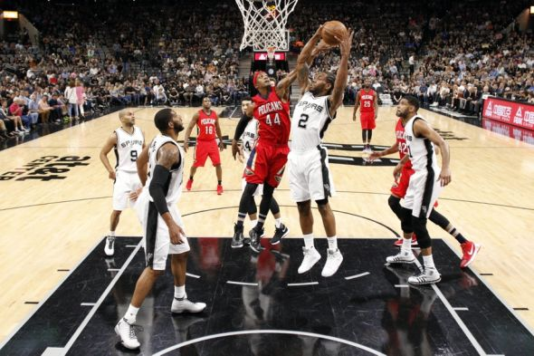
Other Shot
Notes:
If there is another shot within ten seconds, some of the information will overlap
Could be a put-back from a missed shot
http://cdn.fansided.com/wp-content/blogs.dir/377/files/2016/05/dante-cunningham-kawhi-leonard-nba-new-orleans-pelicans-san-antonio-spurs-590x393.jpg

Slide 28
Shot Summary
shot_num 62991
shooter Tony Wroten
game_date 2015-12-18
game_clock 23354
shot_clock 13.57
quarter 2
shot_val 2
other_shot 1
num_poss 1
made False
x_loc 6.27866
y_loc 23.57105
new_x 6.27866
new_y 23.57105
court_zone 2
shooter_dist_to_ball 1.566845
shooter_vel_at_shot 11.03675
shooter_avg_vel 8.81236
shooter_dist_traveled 88.1236
closest_defender Kristaps Porzingis
closest_defender_dist 2.789071
closest_defender_angle 1.187482
closest_def_loc left
num_close_def 3
closest_teammate Jerami Grant
closest_teammate_dist 8.477188
closest_teammate_angle 2.075077
closest_teammate_loc left
num_close_team 0
accel_changes 61

Slide 29
MODELING

Slide 30
Modeling Data
Notes:
Training/Test Set

Slide 31
Test Data
Shot Outcome | Count
Made | 2322
Missed | 3284
41% Made
59% Missed
Notes:
Training data used to fit the models

Slide 32
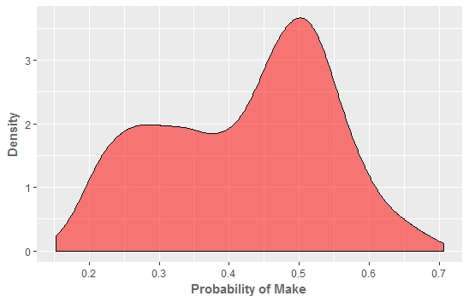
Penalized Logistic Regression
Truth
 | Missed | Made
Missed | 862 | 276
Made | 468 | 357
Predictions
Notes:
- Began with a simple model to determine if a linear relationship was feasible
Performed poorly
Linear relationship is not feasible
Model does not assign shots to be made with a high probability
Most are within 0.2-0.5 range

Slide 33
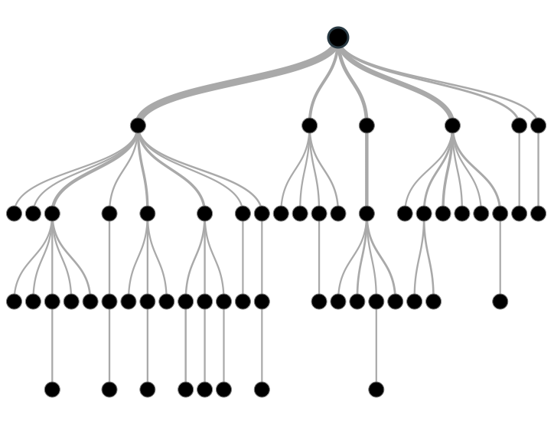
Decision Tree
Truth
 | Missed | Made
Missed | 707 | 431
Made | 429 | 396
Predictions
Notes:
https://www.analyticsvidhya.com/wp-content/uploads/2016/04/dt.png

Slide 34
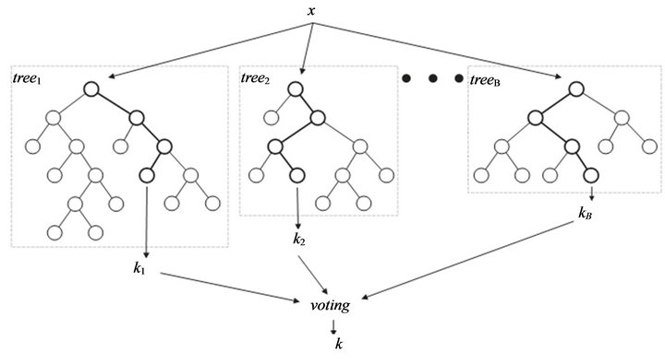
Random Forests
Truth
 | Missed | Made
Missed | 837 | 301
Made | 449 | 376
Predictions

Slide 35
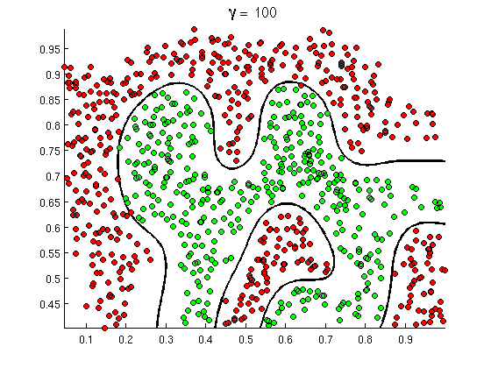
Support Vector Machine
Truth
 | Missed | Made
Missed | 836 | 202
Made | 465 | 360
Predictions

Slide 36
CONCLUSION AND FUTURE WORK

Slide 37
Models were unsuccessful
Notes:
Why were the models unsuccessful?
Features do not account for enough of the variation of whether a shot will go in
Very complicated question that is difficult to analyze
Given the timeframe and data management issues, only time to begin with some simple approaches

Slide 38
Additional Features
Defensive strategy (man-to-man vs. zone)
Account for individual players’ skill levels
Notes:
Initial thought is that more features are needed to account for variation
Defensive strategy: easier to shoot certain types of shots against certain defenses
Players have different skill levels (not enough data for individual models)
Different levels for both offense and defense
Ten seconds might be too long a time – could incorporate moments on defense or that don’t really affect the shot
Would more summary features be enough?

Slide 39
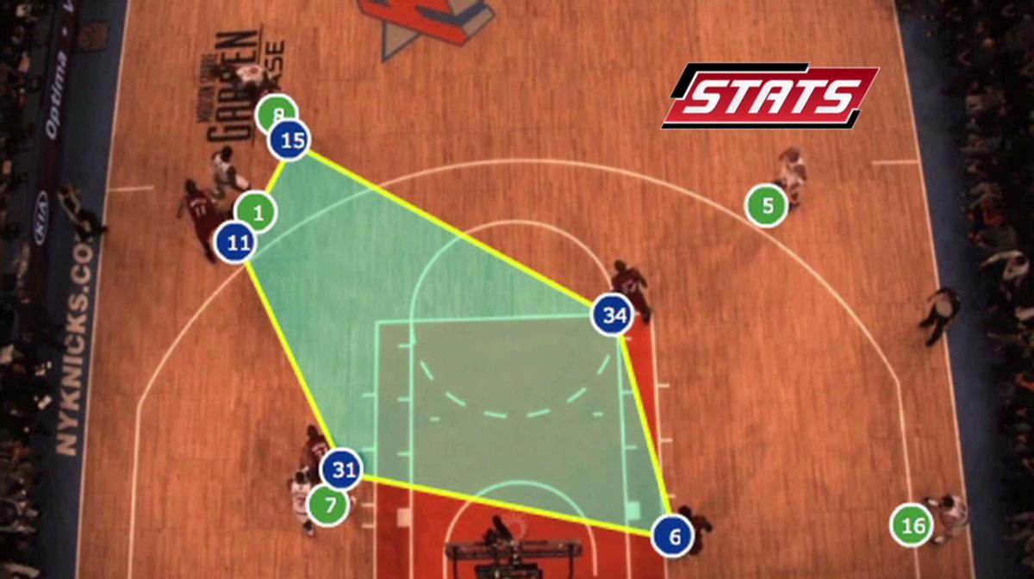
Spatial/temporal aspects
Notes:
Need to incorporate spatial and temporal aspects of the data
Most of the features are summaries of the ten seconds, don’t take into account the positions of all of the players at the time
So much more affecting the outcome of a shot than what is captured in the data
http://www.sporttechie.com/wp-content/uploads/2016/01/130913094124-20130913-stats-2-00000124.1200x672.jpg

Slide 40
Skills Developed
Infrastructure for working with data of this magnitude
JSON files
Working in the terminal, vim
Slurm/screens
Web scraping
Selector in R
Quality assurance
Situations that led to inconsistencies
Identifying ways to check for correctness
Notes:
Found the (lack of) model performance disheartening
However still developed many important skills
- Challenges of working with large data and messy data sets
- How to check that values are reasonable
- Linux environment

Slide 41
Thank You!
Notes:
Why were you interested in this project?
Played basketball for all four years in college
Initially became interested in statistics because of its applications in sport
Project as a way to combine interests in statistics and basketball

